Slide 1
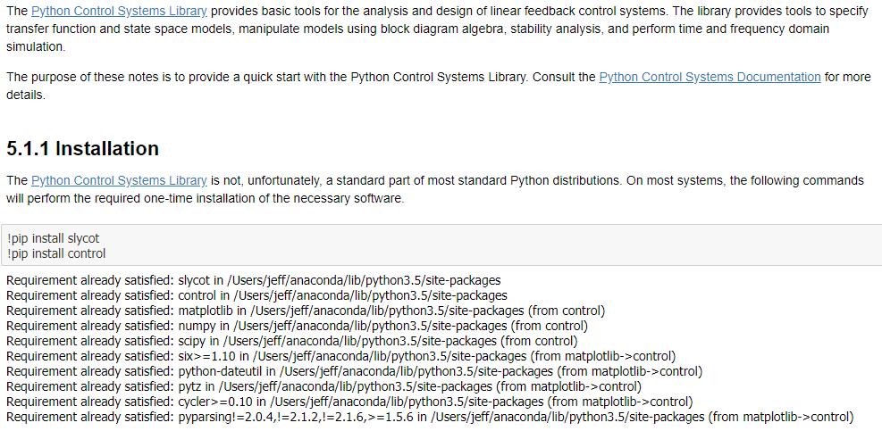
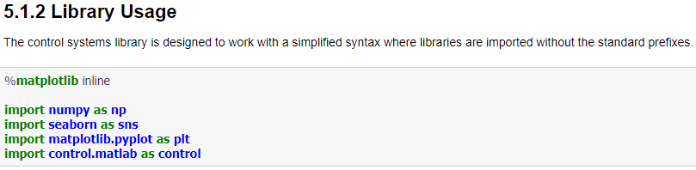
Process Modeling : Getting Started with Transfer Functions

Slide 2
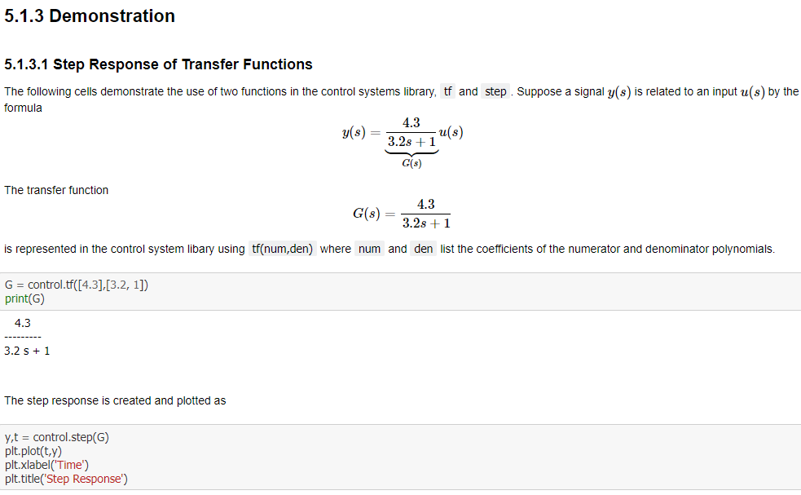
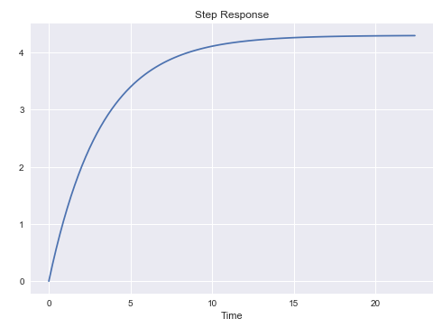
Process Modeling : Getting Started with Transfer Functions

Slide 3
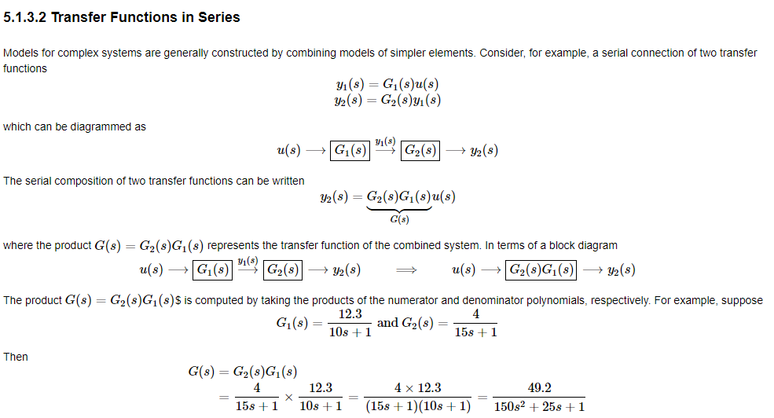
Process Modeling : Getting Started with Transfer Functions

Slide 4
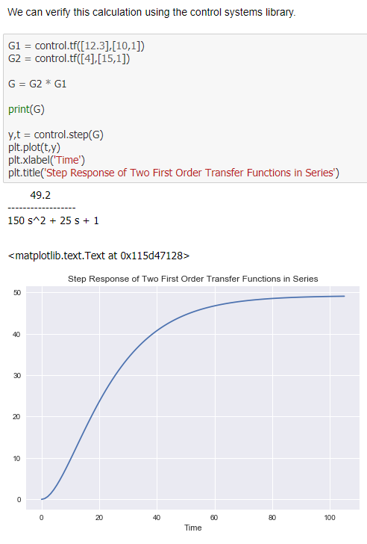
Process Modeling : Getting Started with Transfer Functions

Slide 5
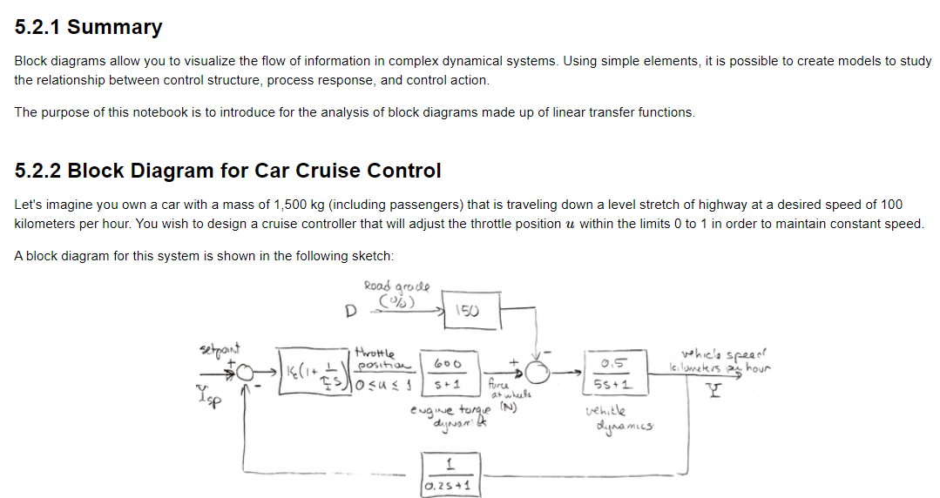
Process Modeling : Closed-Loop Transfer Functions for Car Cruise Control

Slide 6
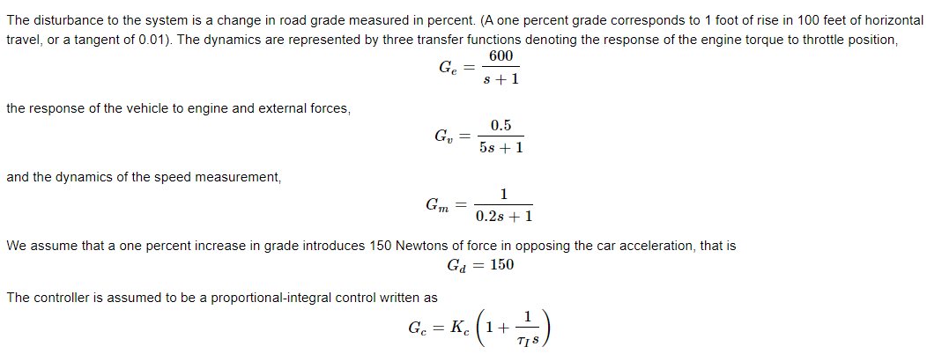
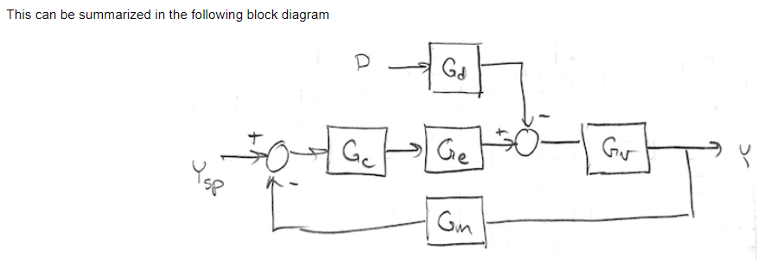
Process Modeling : Closed-Loop Transfer Functions for Car Cruise Control

Slide 7
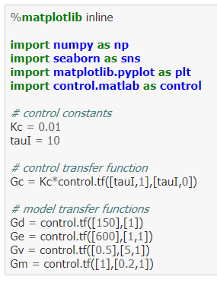
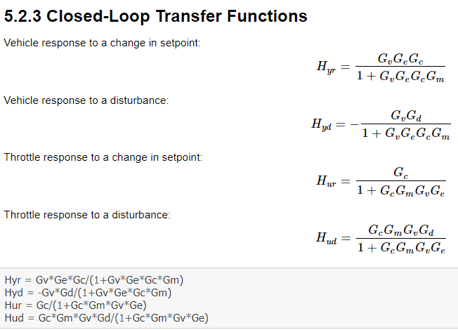
Process Modeling : Closed-Loop Transfer Functions for Car Cruise Control

Slide 8
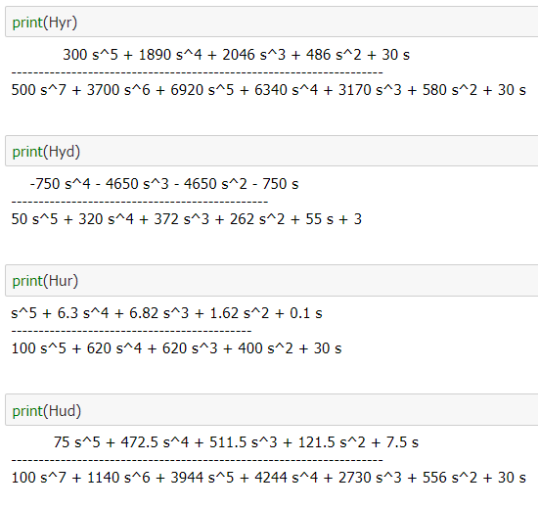
Process Modeling : Closed-Loop Transfer Functions for Car Cruise Control

Slide 9
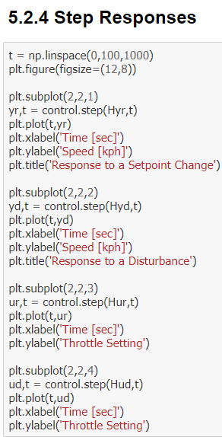
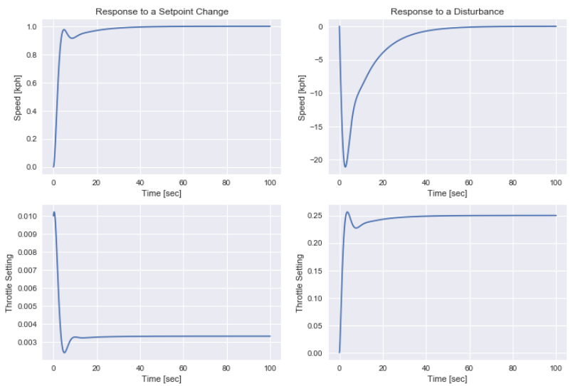
Process Modeling : Closed-Loop Transfer Functions for Car Cruise Control

Slide 10
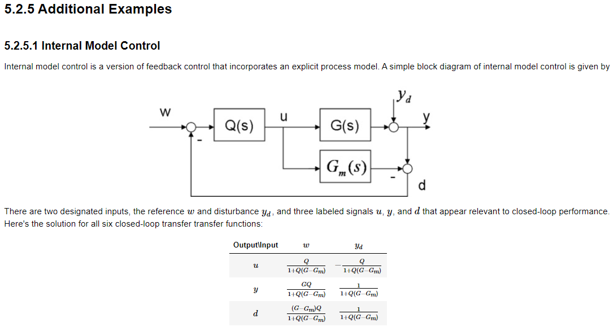
Process Modeling : Closed-Loop Transfer Functions for Car Cruise Control

Slide 11
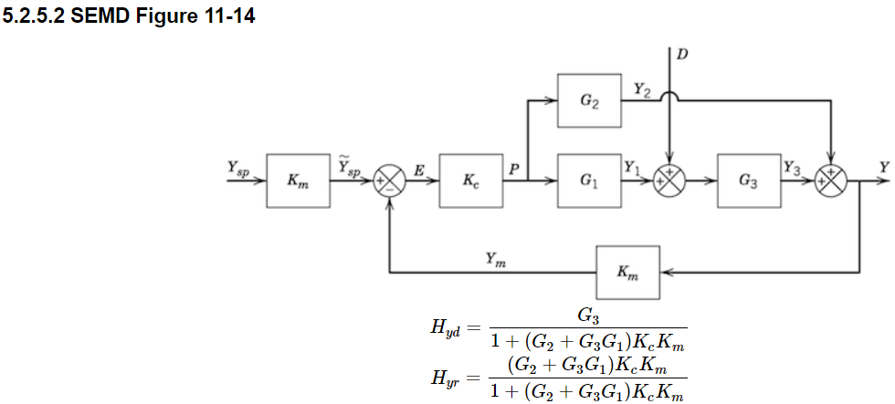
Process Modeling : Closed-Loop Transfer Functions for Car Cruise Control

Slide 12
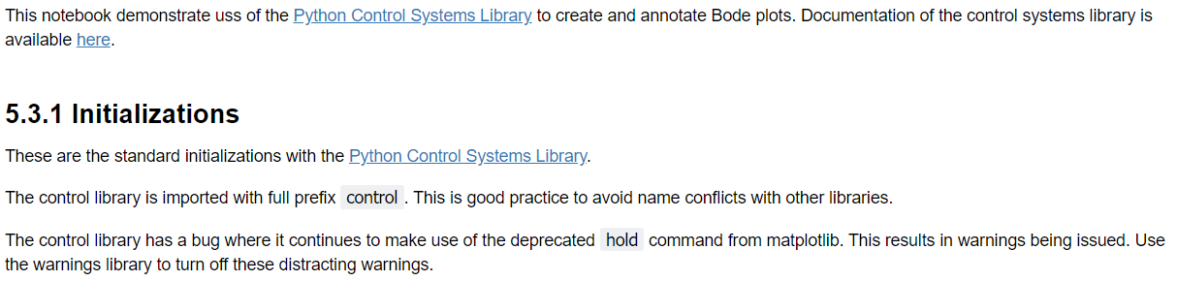
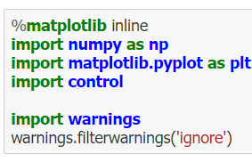
Process Modeling : Creating Bode Plots

Slide 13
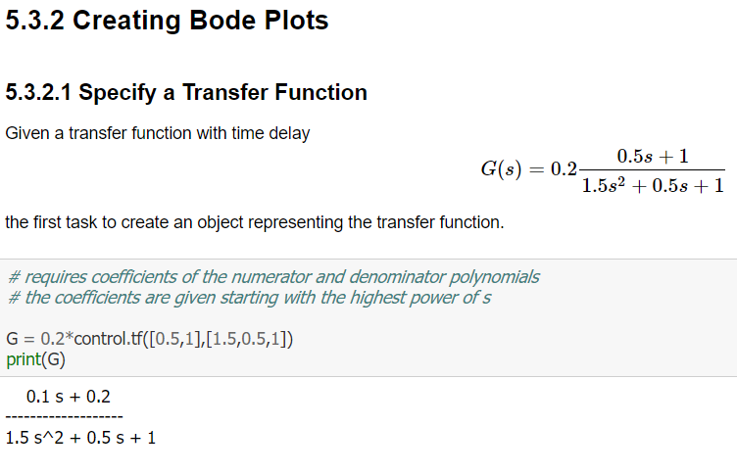
Process Modeling : Getting Started with Transfer Functions

Slide 14
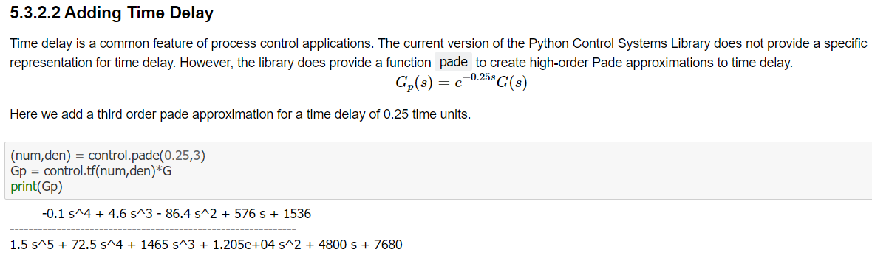
Process Modeling : Getting Started with Transfer Functions

Slide 15
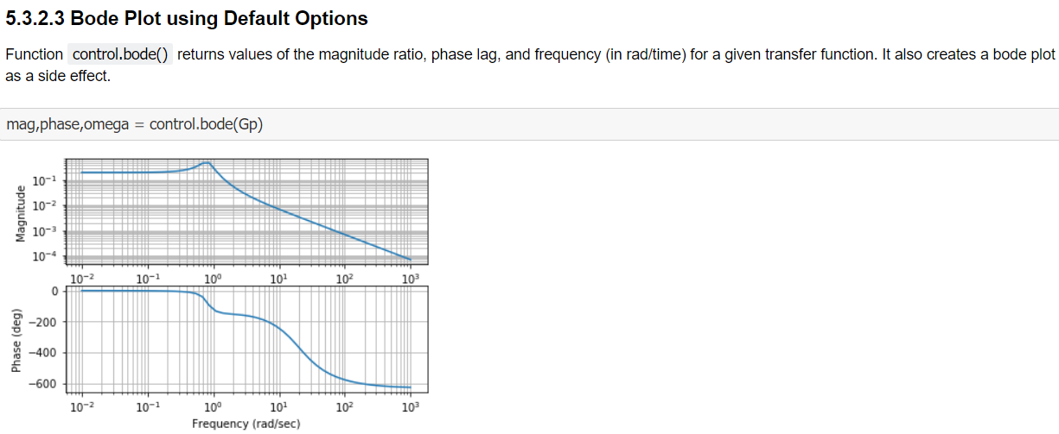
Process Modeling : Getting Started with Transfer Functions

Slide 16
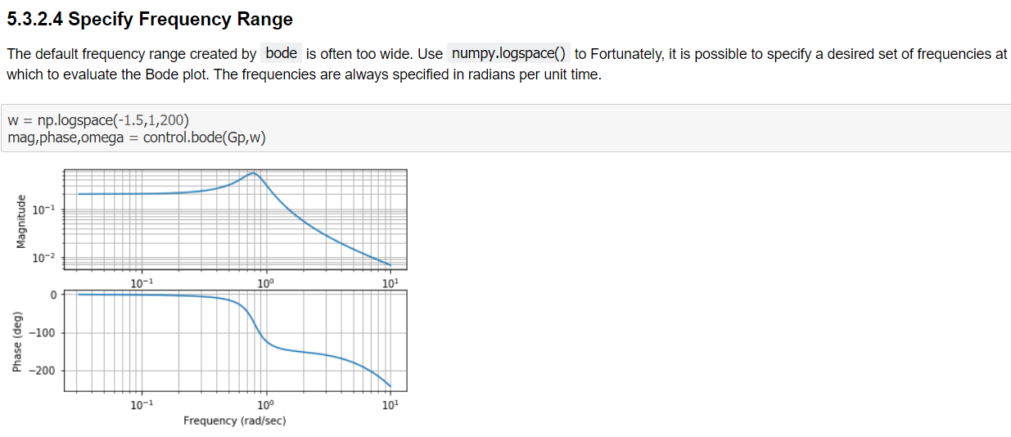
Process Modeling : Getting Started with Transfer Functions

Slide 17
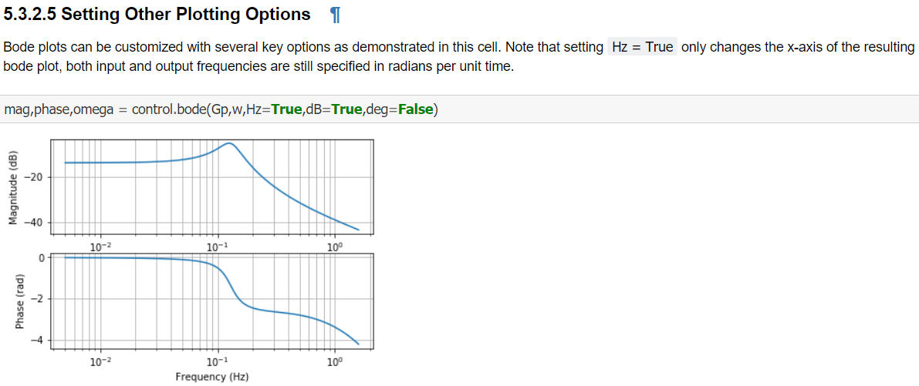
Process Modeling : Getting Started with Transfer Functions

Slide 18
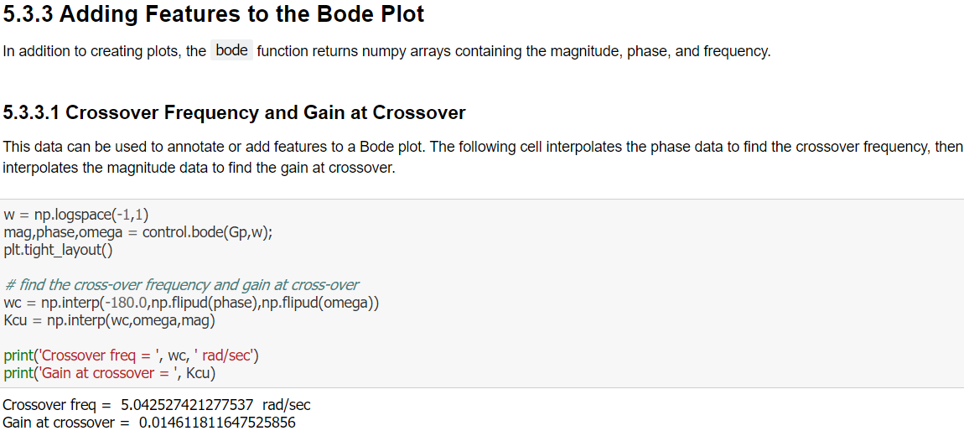
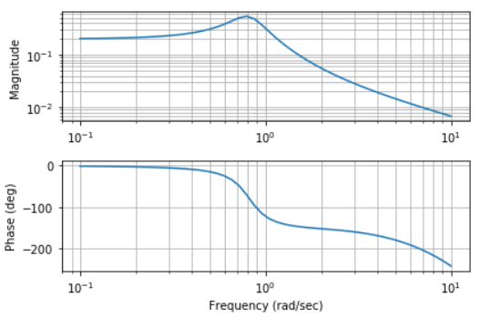
Process Modeling : Getting Started with Transfer Functions

Slide 19
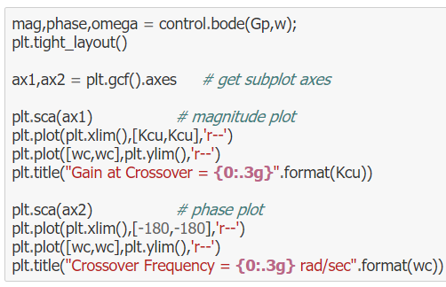
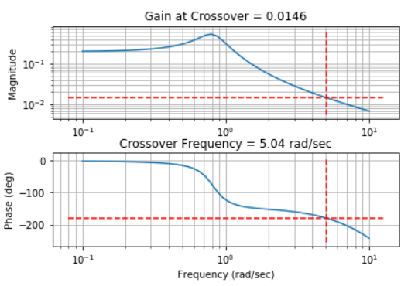
Process Modeling : Getting Started with Transfer Functions

Slide 20
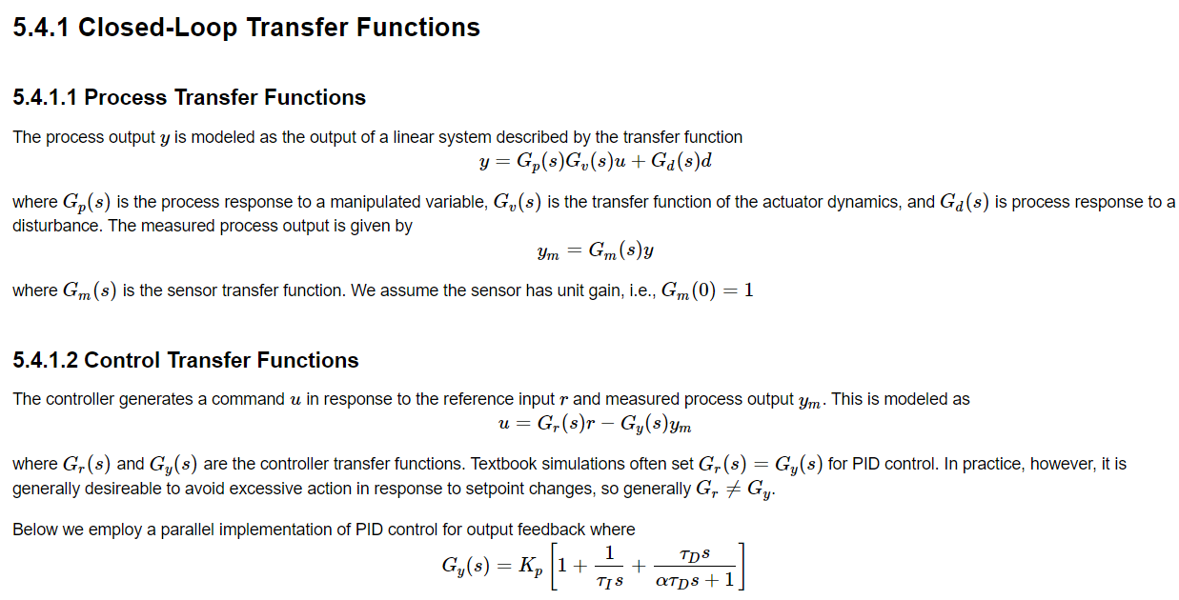
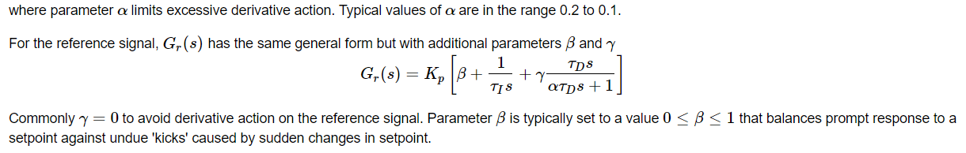
Process Modeling : Controller Tuning Rules in Frequency Domain

Slide 21
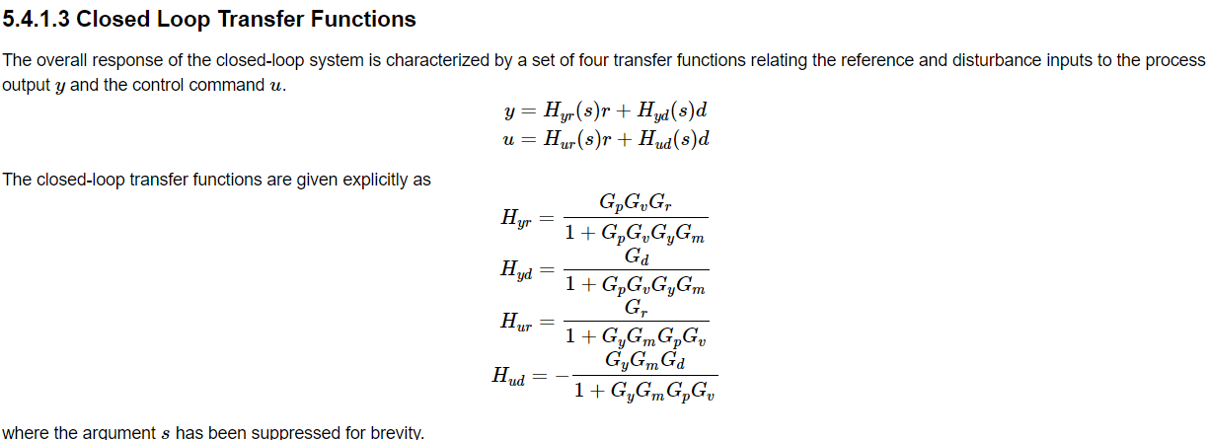
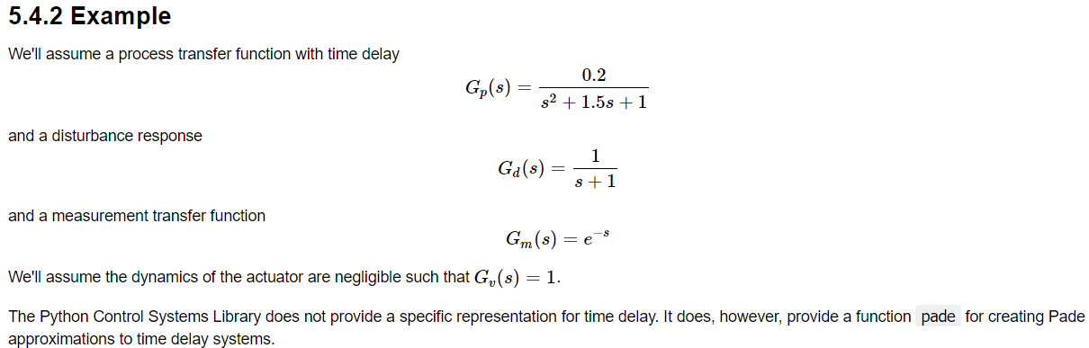
Process Modeling : Controller Tuning Rules in Frequency Domain

Slide 22
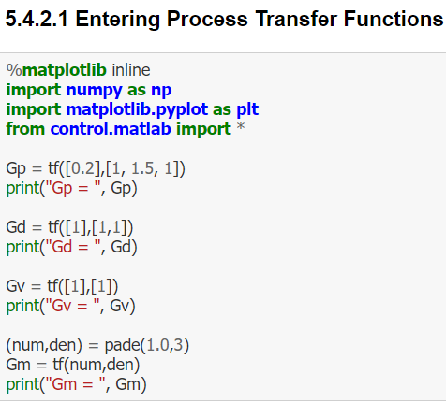
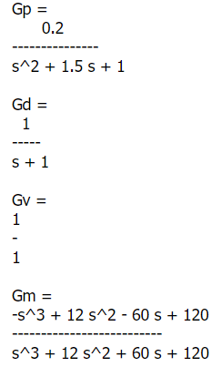
Process Modeling : Controller Tuning Rules in Frequency Domain

Slide 23
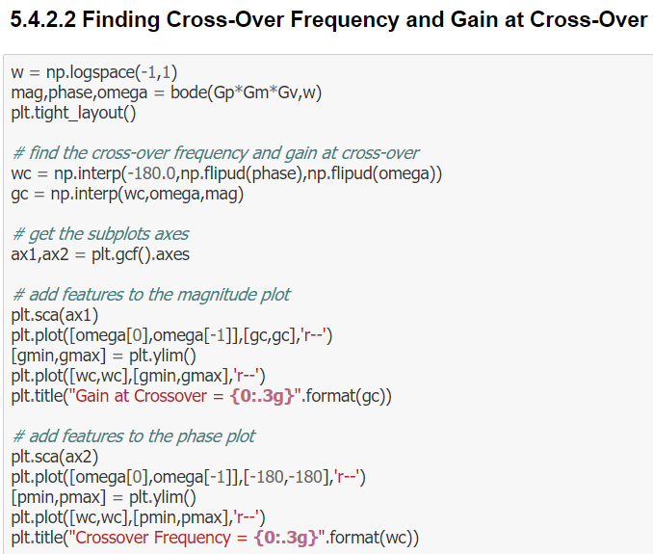
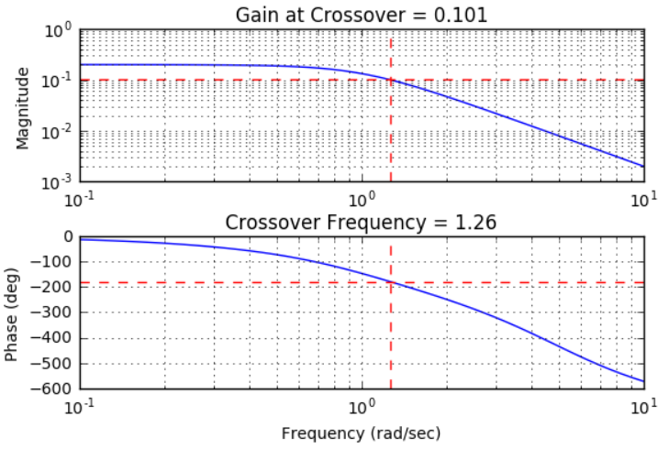
Process Modeling : Controller Tuning Rules in Frequency Domain

Slide 24
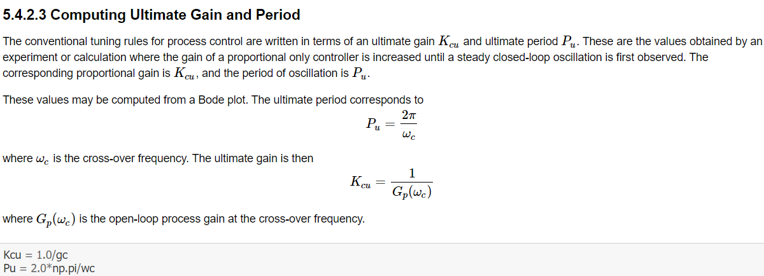
Process Modeling : Controller Tuning Rules in Frequency Domain

Slide 25
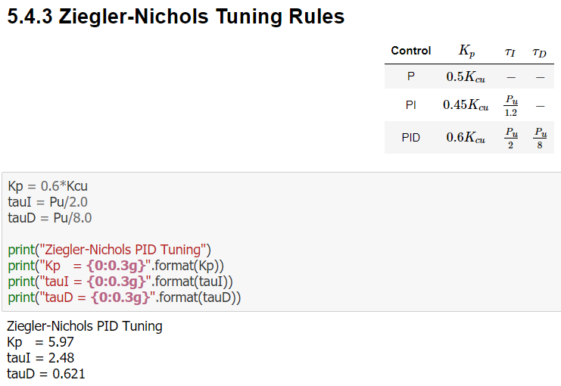
Process Modeling : Controller Tuning Rules in Frequency Domain

Slide 26
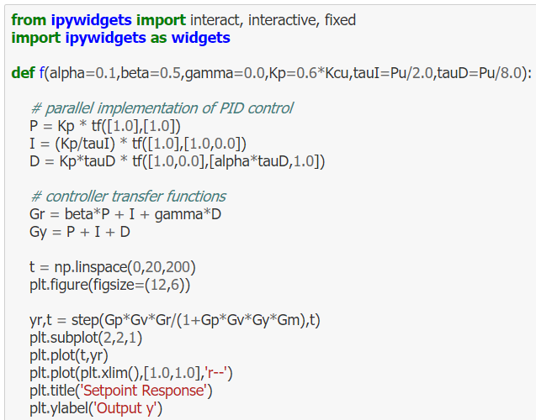
Process Modeling : Controller Tuning Rules in Frequency Domain

Slide 27
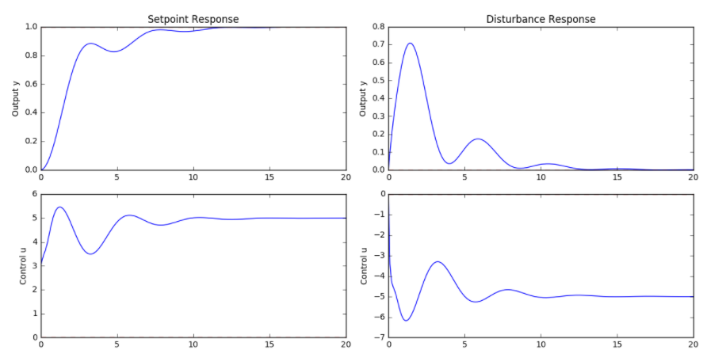
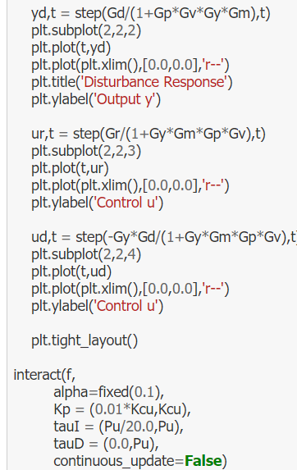
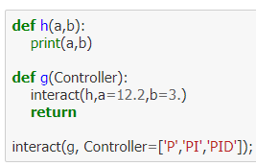
Process Modeling : Controller Tuning Rules in Frequency Domain

Slide 28
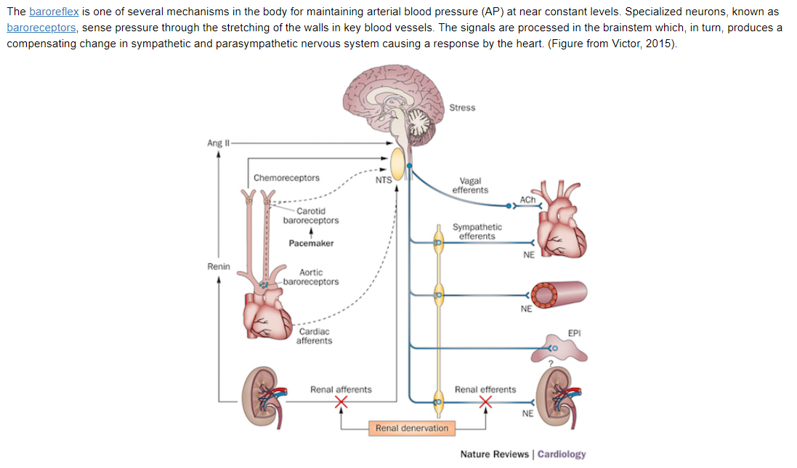
Process Modeling : Baroreflex as a Linear Control System

Slide 29
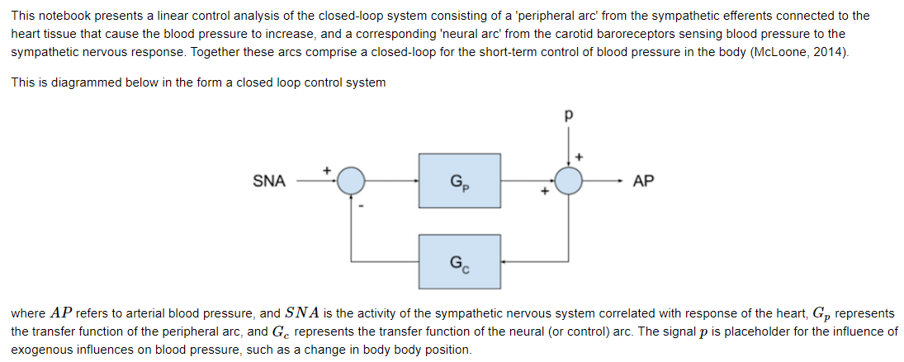
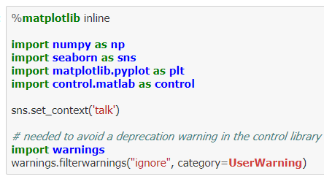
Process Modeling : Baroreflex as a Linear Control System

Slide 30
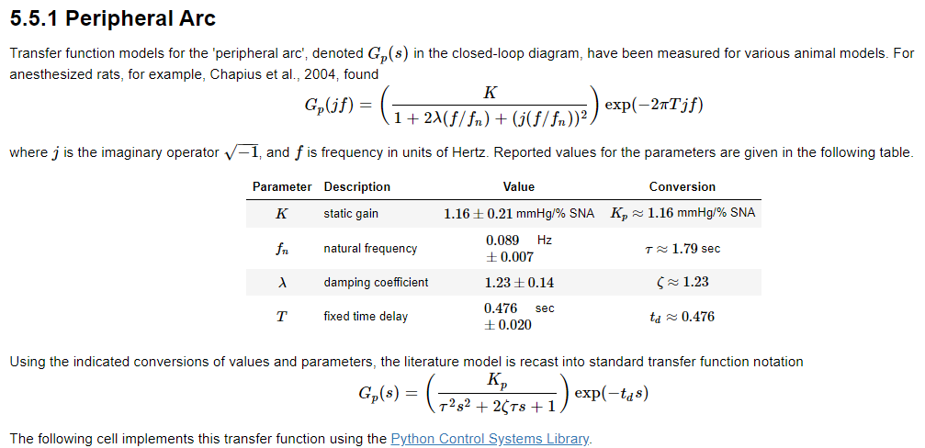
Process Modeling : Baroreflex as a Linear Control System

Slide 31
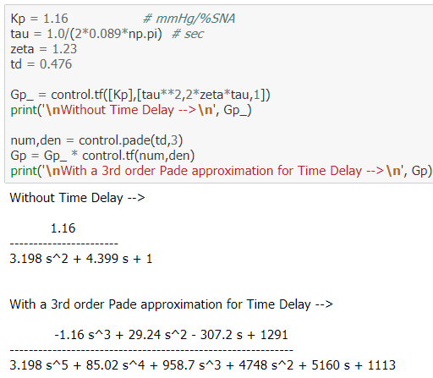
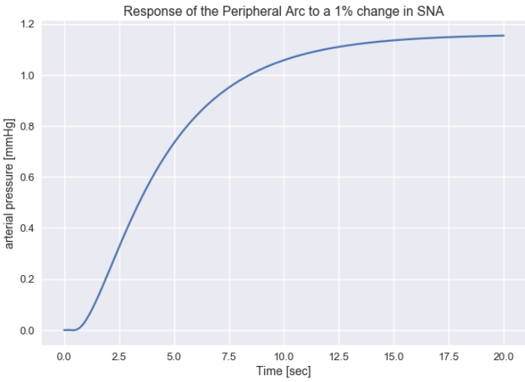
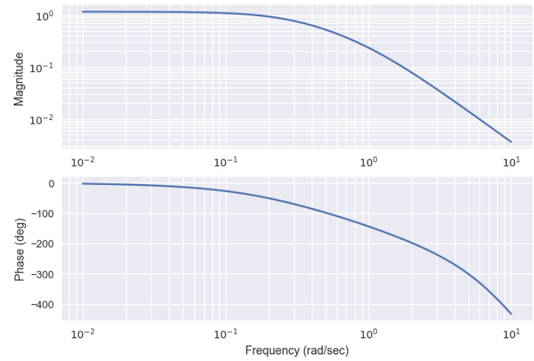
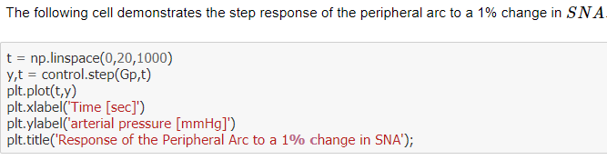
Process Modeling : Baroreflex as a Linear Control System

Slide 32
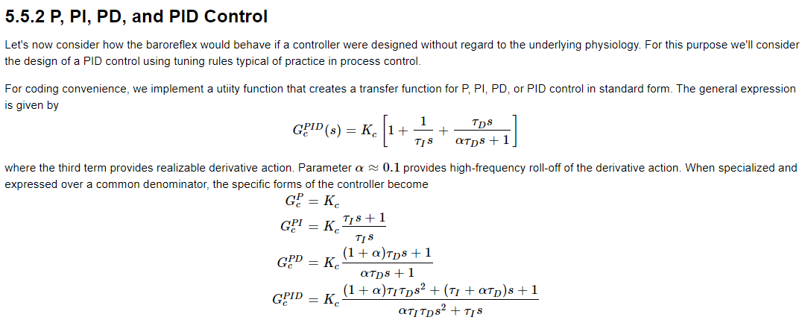

Process Modeling : Baroreflex as a Linear Control System

Slide 33

Process Modeling : Baroreflex as a Linear Control System

Slide 34


Process Modeling : Baroreflex as a Linear Control System

Slide 35

Process Modeling : Baroreflex as a Linear Control System

Slide 36

Process Modeling : Baroreflex as a Linear Control System

Slide 37


Process Modeling : Baroreflex as a Linear Control System

Slide 38



Process Modeling : Baroreflex as a Linear Control System

Slide 39

Process Modeling : Baroreflex as a Linear Control System

Slide 40

Process Modeling : Baroreflex as a Linear Control System

